Slide 1

Pedestrian Detection using HOG, NMS
and Skin Detection
Department of Computer Science and Engineering
NATIONAL INSTITUTE OF TECHNOLOGY DURGAPUR
Under the valuable guidance of:
Dr. Goutam Sanyal
Head, Department of Computer Science
And Engineering
Contributors:
Ranjey Indrajeet Jha 13/CS/03
Drishti Agarwal 13/CS/42

Slide 2
OBJECTIVE
We present an approach to pedestrian detection in images, which can be easily extended to videos.
We apply a HOG descriptor and employ a linear SVM to detect pedestrians on a structural level.
To further advance our detection, we apply skin segmentation to the cropped area of the detected pedestrian to distinguish a human from any human-like statue or sign boards.

Slide 3
TECHNIQUES USED
HOG (Histogram of Oriented Gradients)
NMS (Non-Maximum Suppression)
Skin Color Segmentation

Slide 4
HOG (Histogram of Oriented Gradients)
The histogram of oriented gradients (HOG) is a feature descriptor used in computer vision and image processing for the purpose of object detection.
The technique counts occurrences of gradient orientation in localized portions of an image.
The image is divided into small connected regions called cells, and for the pixels within each cell, a histogram of gradient directions is compiled. The descriptor is the concatenation of these histograms.

Slide 5
NMS (Non-Maximum Suppression)
Non-maximum suppression is used as an intermediate step in many computer vision algorithms.
Non-maximum suppression is often used along with edge detection algorithms.
The image is scanned along the image gradient direction, and if pixels are not part of the local maxima they are set to zero.
This has the effect of suppressing all image information that is not part of local maxima.

Slide 6
Skin Color Segmentation
Skin detection is the process of finding skin-colored pixels and regions in an image or a video.
This process is typically used as a preprocessing step to find regions that potentially have human faces and limbs in images.
A skin detector typically transforms a given pixel into an appropriate color space and then use a skin classifier to label the pixel whether it is a skin or a non-skin pixel.

Slide 7
PROCEDURE
During the initial runs of the code, we tried to extract any human figure from a given image based on the structural disposition of humans.
We used HOG descriptors to achieve that purpose. The problem faced by us after the first run was of multiple bounding boxes detected for a single pedestrian body.
To fix the above complication, we introduced non-maximum suppression to reduce the multiple bounding boxes to an all-enclosing single bounding box.
To further enhance the efficiency of our code, we cropped our image with respect to the above bounding box and applied skin tone segmentation to it to confirm the presence of skin-like regions on the cropped area.

Slide 8
EVALUATION METHODOLOGY
We implement our code by exploiting the functions available to us in OpenCV-Python
Input :
We take images as inputs which contain pedestrians which are to be detected and confirmed.
Output :
We display only the pedestrian with a bounding box around it and also show a window displaying the skin areas on the pedestrian detected to confirm the presence of a human.

Slide 9
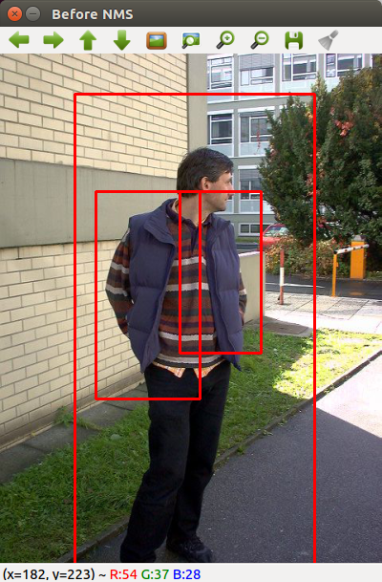
Sample Run : 1
Here we detect a person, and initially get multiple bounding boxes for the same person in the frame.

Slide 10
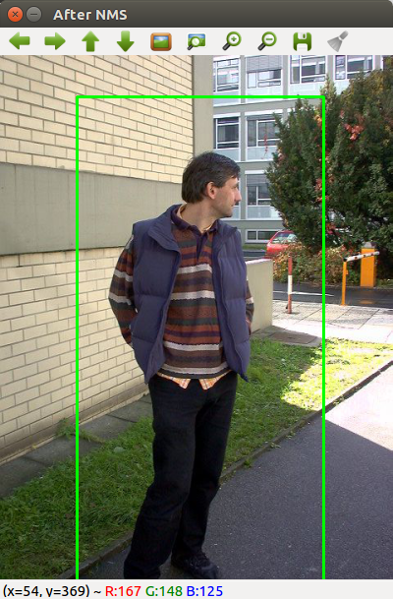
Sample Run 1: continued
After applying NMS, our results get better and the entire person is confined within a single bounding box.

Slide 11
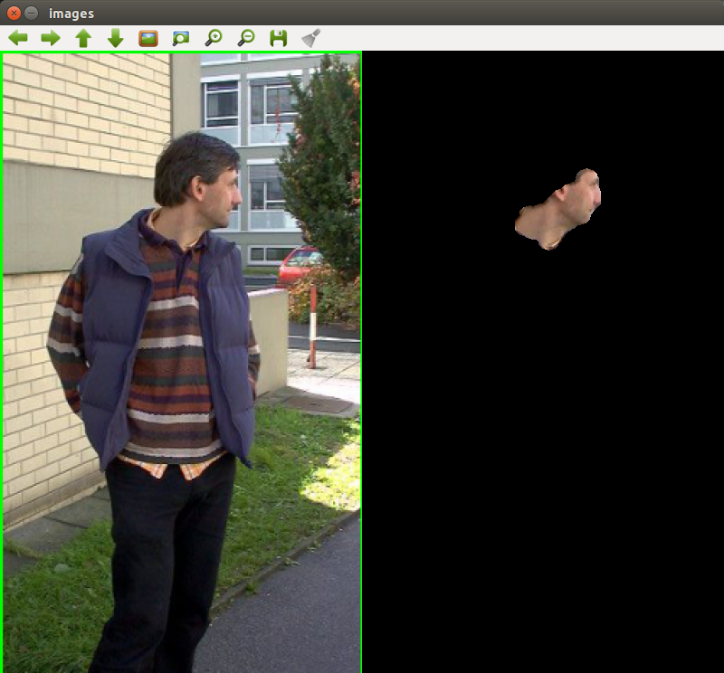
Output of Sample Run : 1
After cropping the bounding box received earlier, we apply skin color segmentation and we are able to efficiently segment the skin areas from the person's body thus confirming him as a human pedestrian.

Slide 12
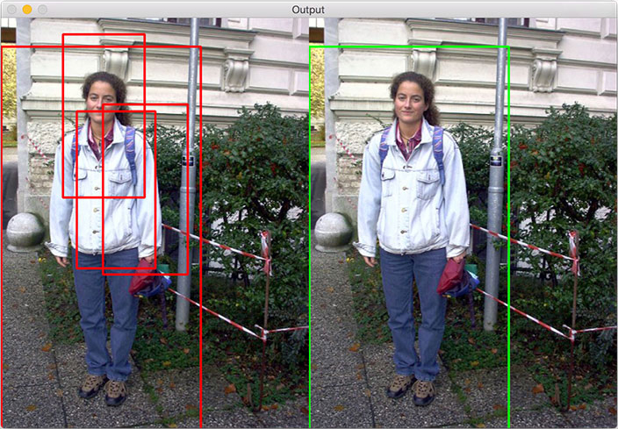
Sample Run:2
In this run, we are again able to efficiently detect a pedestrian and enclose it within a single bounding box using NMS.

Slide 13
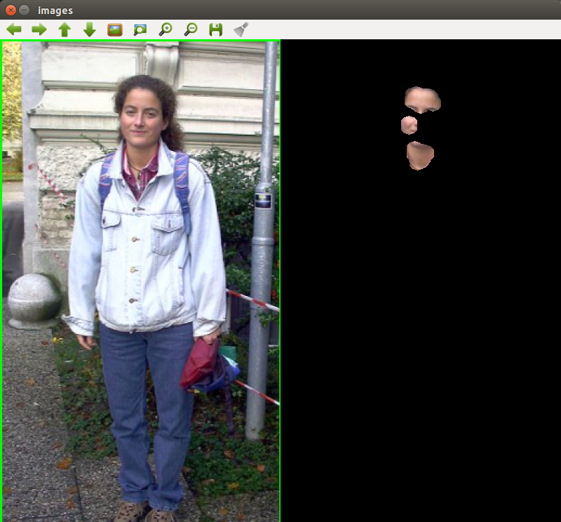
Output of Sample Run:2
We observe that in our result, i.e. the final output, skin is detected by our code, hence it confirms that in the input image, human is present.

Slide 14
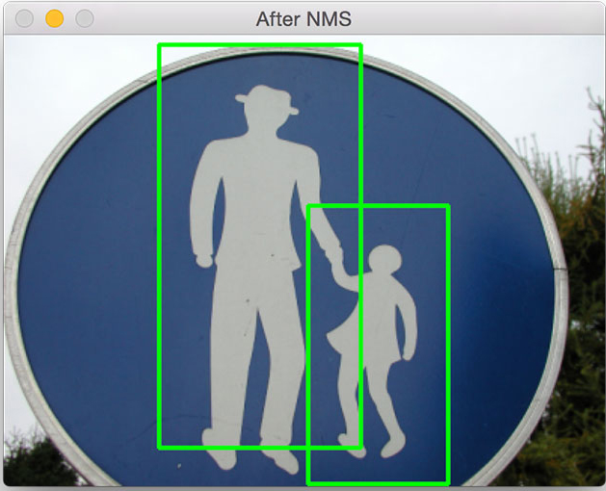
Sample Run:3
This particular result is the one that most clearly distinguishes between an actual human body and a pedestrian – like figure. Here, our HOG descriptor detected it as a human figure and we extracted that information and stored it in a bounding box.

Slide 15
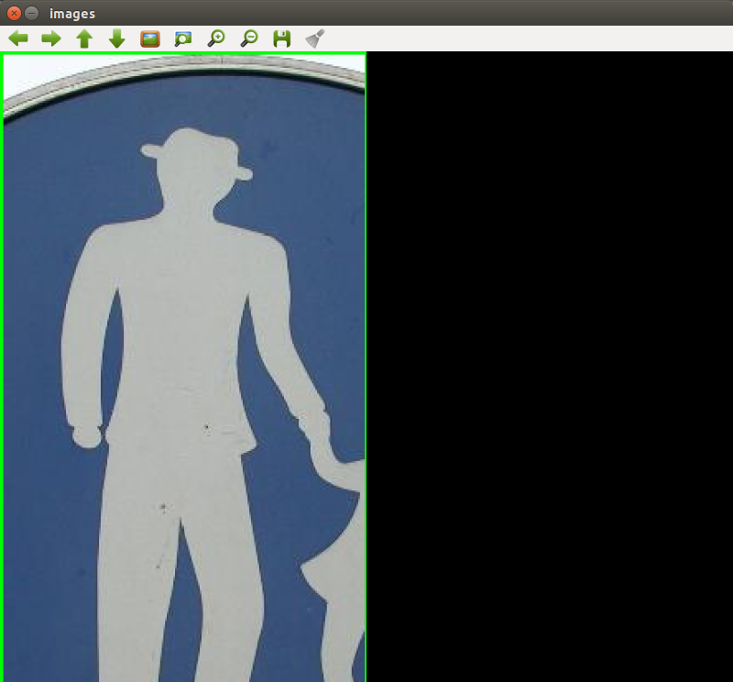
Output of Sample Run:3
After applying skin segmentation, we can now be assured that although it appeared to be a pedestrian at first, it is a false detect, as there was no skin found inside the bounding box. Hence, it won’t be detected as a pedestrian, making our code efficient.

Slide 16
CONCLUSION
While this might not be a perfect or robust approach, the simplicity of our detection algorithm makes it a very good starting point to build more robust solutions.
We conclude that with HOG and Linear SVM, followed by skin color segmentation, we can detect pedestrian with very great accuracies.
This simple pedestrian detector can act as a resource for many other ideas that somedays back were thought to be inexecutable.

Slide 17
SCOPE OF FUTURE WORK
While the HOG method tends to be more accurate than its Haar counter-part, it still requires that the parameters to detectMultiScale be set properly.
Under different lighting conditions, this approach might not perform as well and we would likely have to continue to tweak the HSV value ranges.
The same HSV values used to detect my skin could not be used to detect someone from Asia or Africa. This implies that we have some a priori knowledge regarding the skin tone of who we want to detect.
Of course, more robust approaches can be applied. A (highly simplified) example would be to perform face detection to an image, determine the color of the skin on their face, and then use that model to detect the rest of the skin on their body.

Slide 18
THANK YOU! ☺

